Slide 1
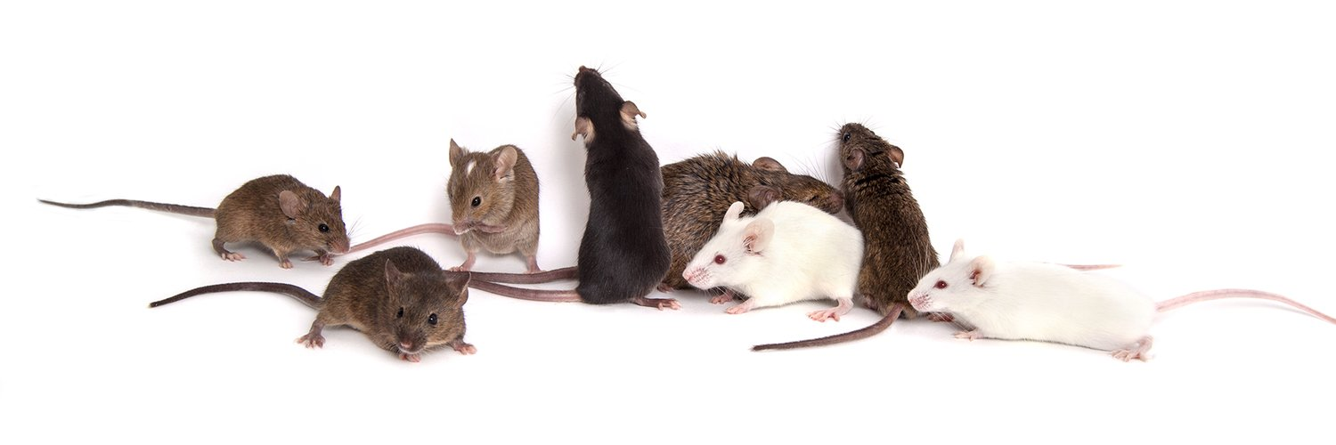
Defining the consequences of genetic variation on a proteome– wide scale:
QTL Mapping with the Diversity Outbred Mouse Lines
Danny Antaki
12/07/2018
Gleeson Lab Meeting

Slide 2
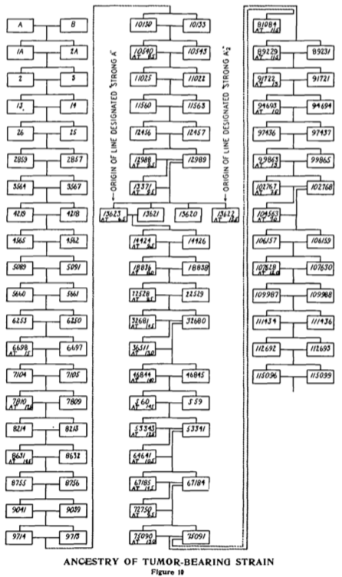
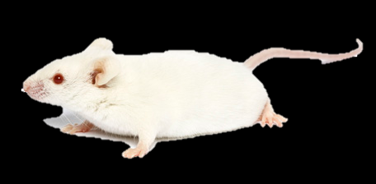
Mus musculus: Genetic Workhorse
The importance of isogenic model organisms has been recognized for over 100 years
However, inbred model have limitations
Trait | Inbred | Outbred
Isogenic | ✅ | ❌
Consistent Phenotype | ✅ | ❌
Experimental Reproducibility | ✅ | ❌
Hybrid Vigor (lack of inbreeding depression) | ❌ | ✅
Genetic Mapping | ❌ | ✅
Quantitative Trait Locus (QTL) Mapping | ❌ | ✅
Model of Human Diversity | ❌ | ✅
“In the summer of 1921 I obtained two albino mice while working at … Cold Spring Harbor. One of these ‘A’ came from the stock that Dr. Little had been continuing at that institution. The exact origin of this mouse is uncertain.“ – Leonell Strong On the Establishment of the “A” Strain of Inbred Mice. 1936

Slide 3
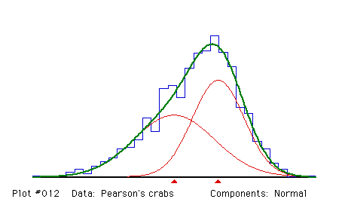
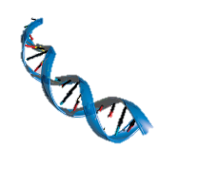
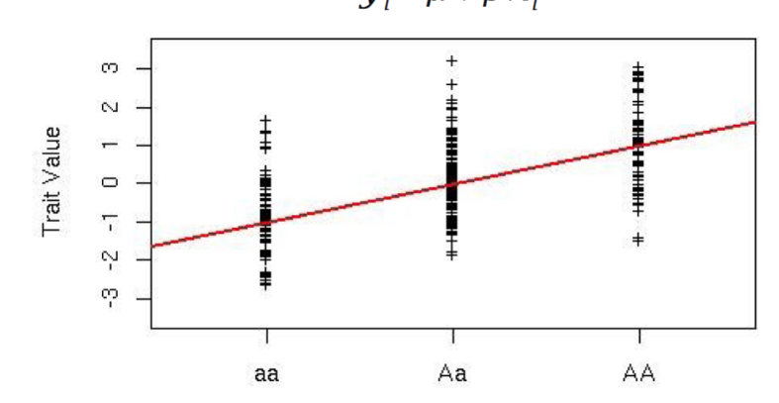
Quantitative Trait Locus (QTL) Mapping
QTLs are responsible for variable phenotypes
Genetic contribution of phenotypes
Not discrete phenotype (eg. wrinkled peas)
Most mapping models are linear
Genotype as the predictor
Quantitative trait as the response
Add the effect of covariates
age, sex, kinship
❓

Slide 4
QTL Mapping in Model Organisms
QTL mapping in humans require:
Large sample sizes
Common variants
Variable phenotypes
Advantages of QTL mapping in model organisms
Control genetic diversity
Genetic markers are common
Wide-degree of phenotype
Requires out-crossing

Slide 5
Collaborative Cross (CC) Inbred Lines
8 inbred strains as founders
A/J | Albino
C57BL/6J | Reference Strain
129S1/SvImJ | ESC line, Kitl (Steel) mutant
NZO_HILtJ | “New Zealand Obese”
NOD/ShiLtJ | “Non-Obese Type 1 Diabetic”, Albino
CAST/EiJ | Wild Derived from Thailand
PWK/PhJ | Wild Derived from Czech Republic
WSB/EiJ | Wild Derived from Bethesda, MD
CC mice are homozygous at nearly every locus
F1 crosses for 20 generations
After 20 generations
inter-line crosses can be be outbred to over 1M reproducible genomes (recombinant inbred intercrosses)

Slide 6
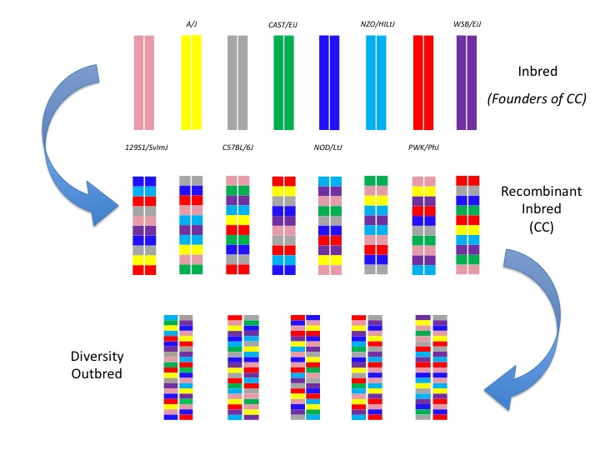
Diversity Outbred (DO) Lines
144 independent CC lines
Same 8 founders:
37.8M SNPs
6.9M INDELs+SVs
Minimum AF of 1/8
Each line is a unique genome
Mating is randomized at each generation

Slide 7
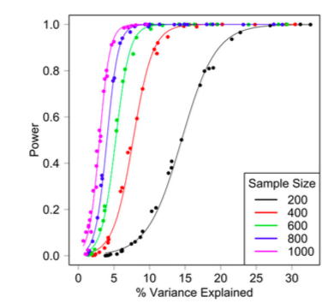
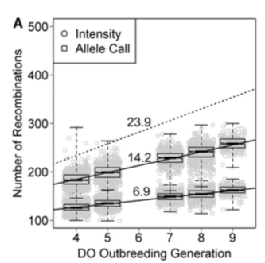
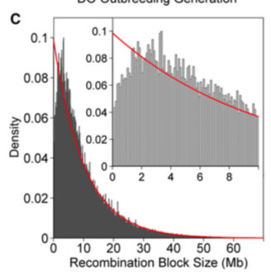
DO mice have similar genetic attributes as humans
Heterozygosity similar to humans
Drawback: each animal is unique
Combinations of genotypes can be replicated by CC lines or F1 crossings

Slide 8
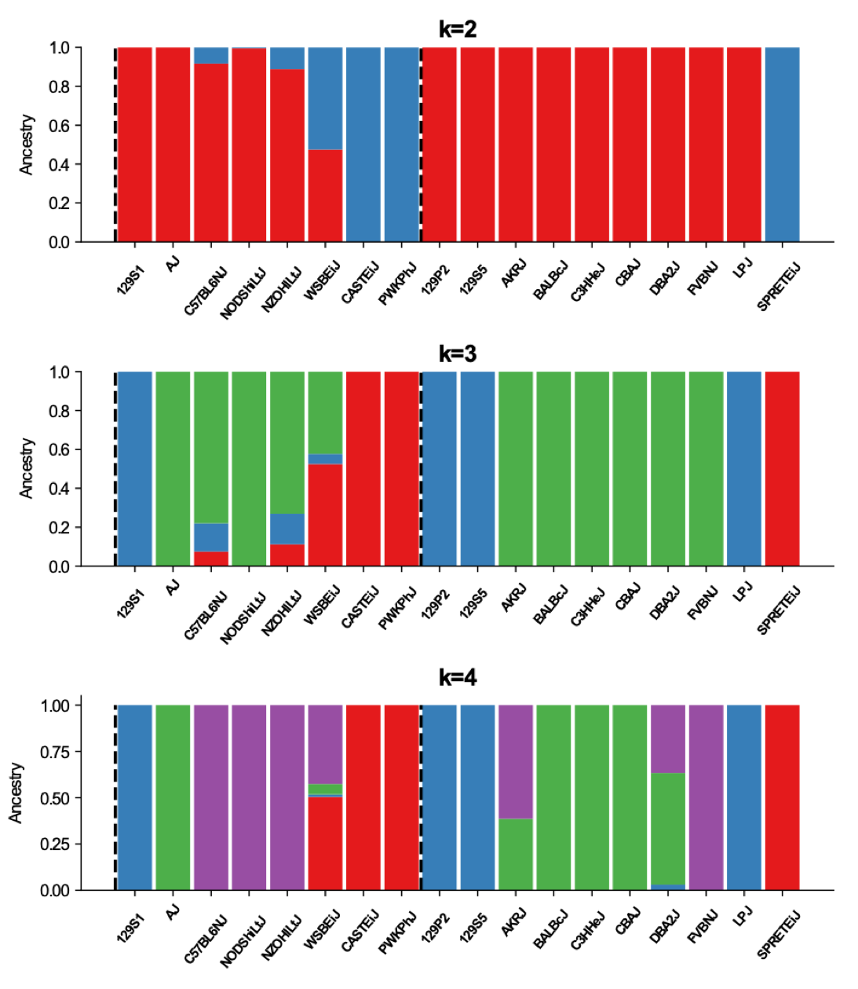
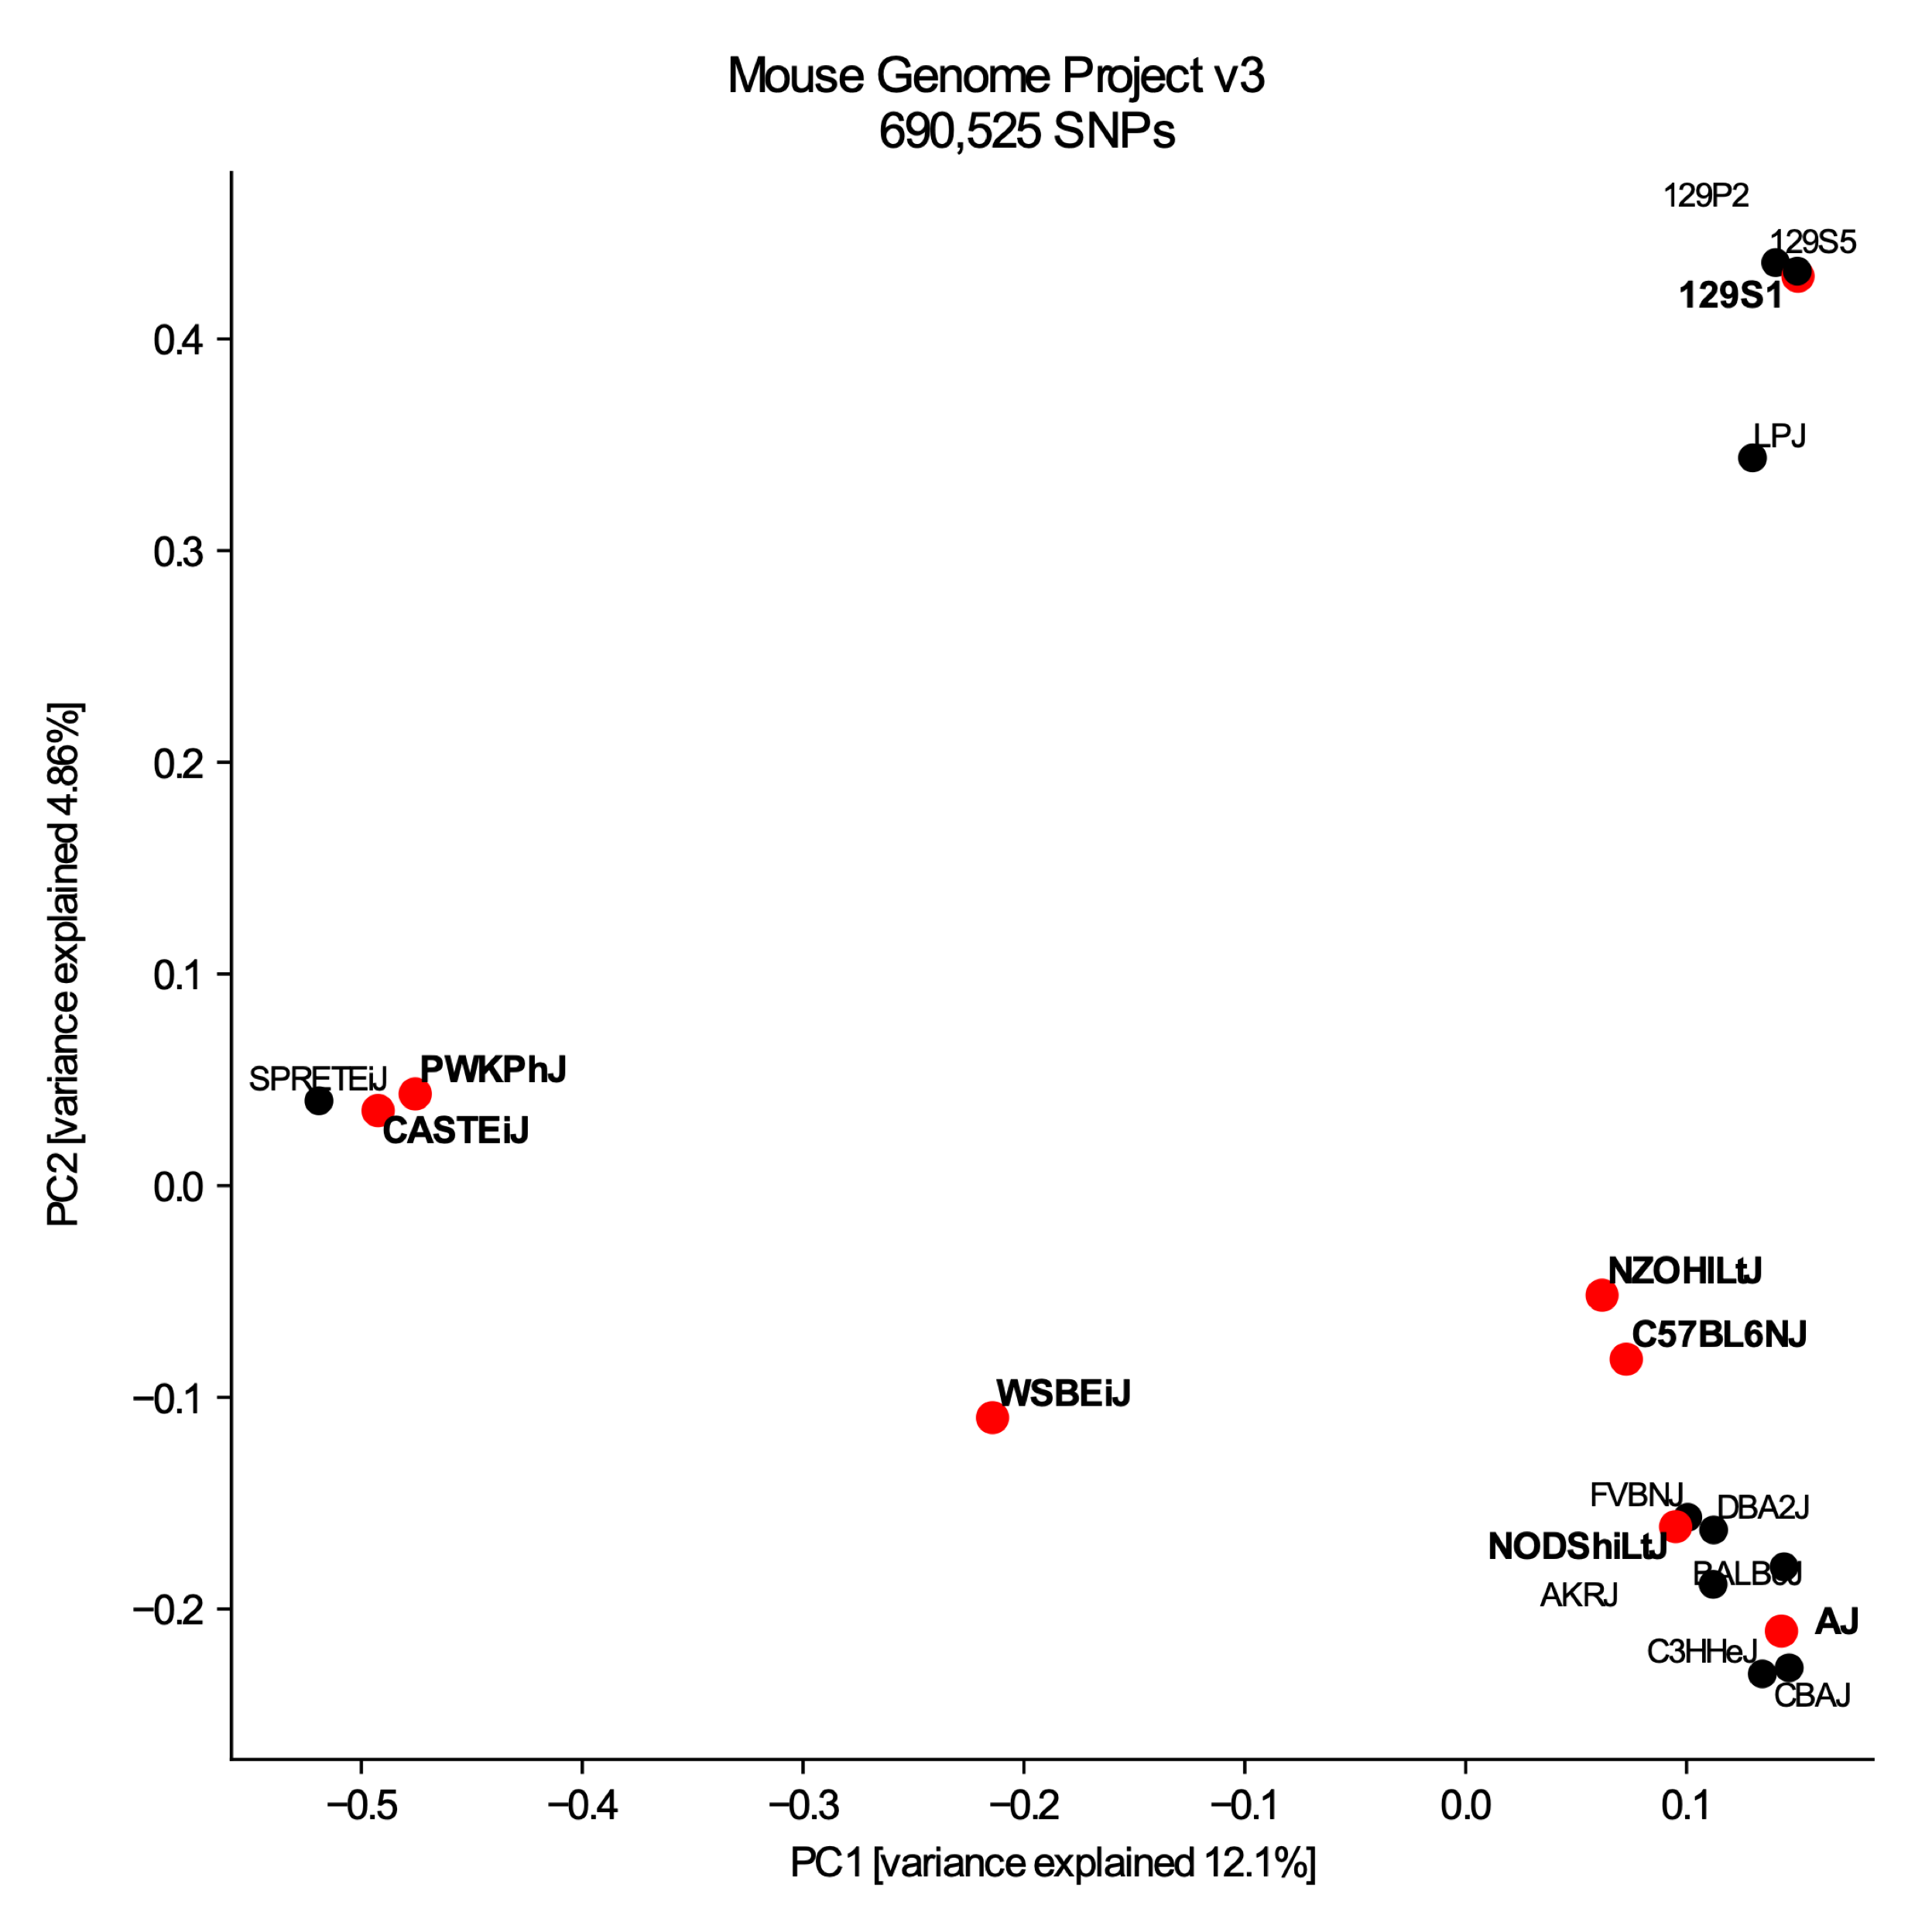
Population Structure of Inbred Mice
DO Founders
Downloaded SNPs from the Mouse Genome Project
Removed SNPs within LD (r² > 0.05)
Clusters of wild-derived, lab inbred, and (possibly) fancy mice
Strains in red are DO founders
hobby mouse
wild derived

Slide 9
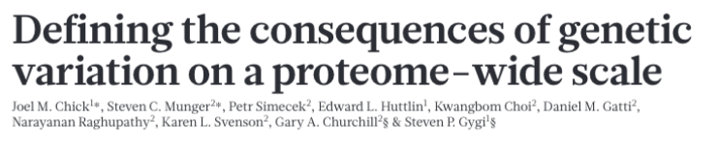
Collaboration between Jax Laboratories (Churchill) and Harvard Medical School (Gygi)
Leveraged DO lines, RNAseq, and quantitative mass spec to find QTLs for transcription (eQTL) and translation (pQTL) in livers
To what extent transcript abundance is a predictor of protein abundance?

Slide 10
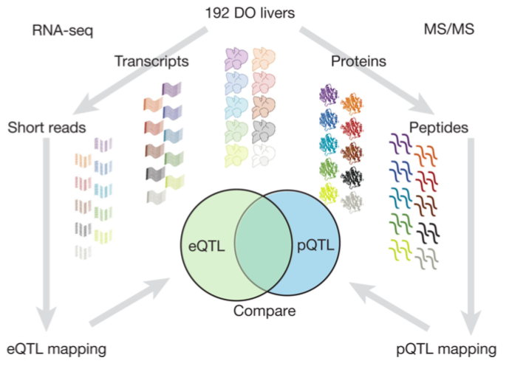
Methodology in Brief
192 DO mouse lines
Determine QTL for transcripts and proteins in liver
Characterize different QTL flavors
Local, distant, pleiotropic
Compared results with replication cohort of 192 independent DO lines

Slide 11
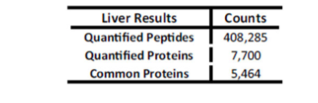
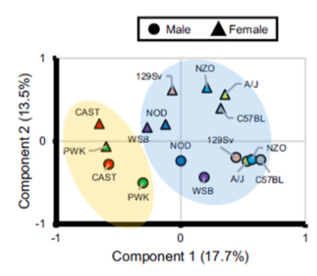
Genetic Background Drives Translational Status
Measured liver protein abundance in the 8 founder strains
Most of the explained variance was due to strain, then sex
Imply QTL mapping in outbred lines is feasible

Slide 12
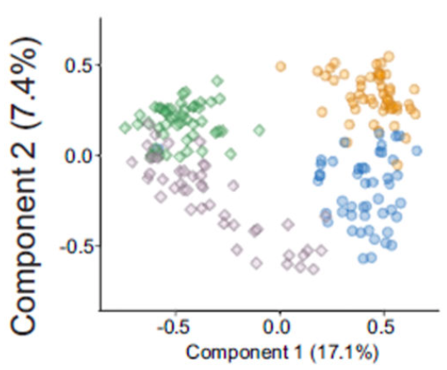
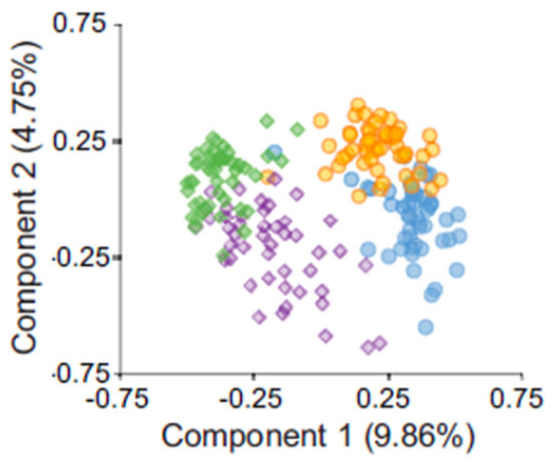
Effect of Sex and Diet on DO Mouse Lines
Profiled transcript and protein levels in 192 DO lines
Sex and then diet were the major drivers of variation for both transcript and protein abundance
Genetic background explained more variation than sex or diet.
protein
transcript

Slide 13
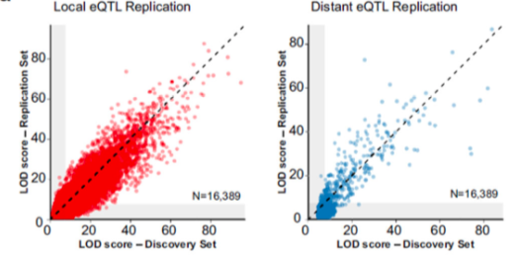
Mapping QTLs of 6,706 proteins
Test the association of 6,706 proteins
Both protein and transcript were detectable in half of the samples
2,866 pQTLs for 2,552 proteins
4,188 eQTLs for 3,706 genes
Local interactions more common than distant
1,736 local pQTLs / 1,130 distant pQTLs
3,211 local eQTLs / 977 distant eQTLs
Appreciable replication rate in 192 independent DO lines

Slide 14
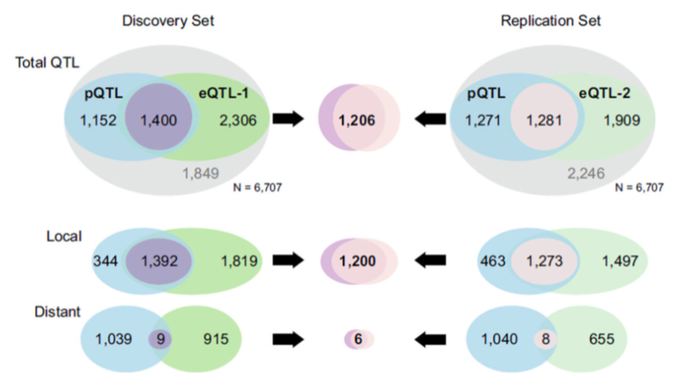
Local QTLs Influence Both Transcript and Protein Amounts
Genes with concordant QTLs had correlated transcript and protein abundance
Small number of local pQTL without eQTL maybe be explained by variants that affect protein stability
Defects of post-transcriptional functions
Missense mutations
80% of local pQTL had a corresponding eQTL

Slide 15
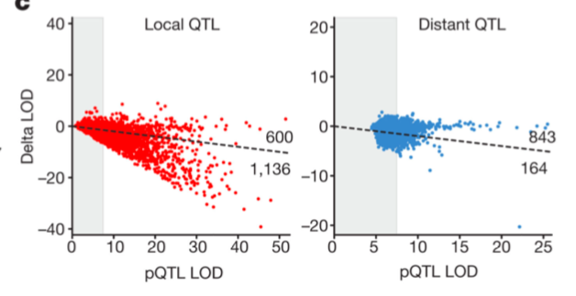
Distant pQTLs affect protein abundance post-transcriptionally
Most distant pQTLs were exclusive from distant eQTLs
The effect of transcription abundance was added to the model
Local pQTL were more likely to be regulated by transcriptional mechanisms

Slide 16
Detour: Mediation Analysis
First used by social scientists and psychologists
Test of the effect of other variables
Add the effect to the regression model
Mediators
QTL
Genetics + Environment = Phenotype
QTL
Environment Effect | Significance Difference
Strong | High
Weak | Low

Slide 17
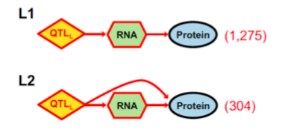
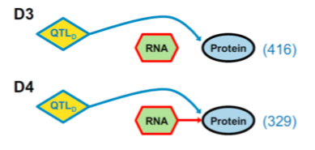
Most local QTLs effected transcript and protein abundance
Local QTLs
(N QTLs)
Bayesian Information Criteria
Used to find the best model from a finite set of models
Distant QTLs effected protein levels post-translationally
Distant QTLs
(N QTLs)

Slide 18
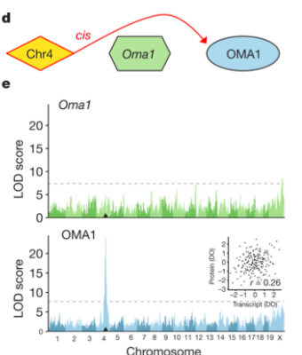
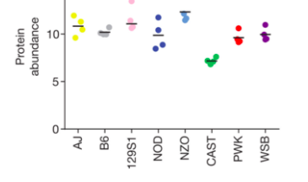
Missense mutations can lower protein abundance independent of transcript
Transcript
4 missense mutations in Oma1
Deirved from CAST ancestor
Likely affects protein stability
Protein
Notes:
s a metalloprotease, this protein is a substantial component of the quality control system in the inner membrane of mitochondria. Being activated by enzyme Bax and Bak, mitochondrial protease OMA1 promotes cytochrome c release which subsequently induces apoptosis.^{[7]}

Slide 19
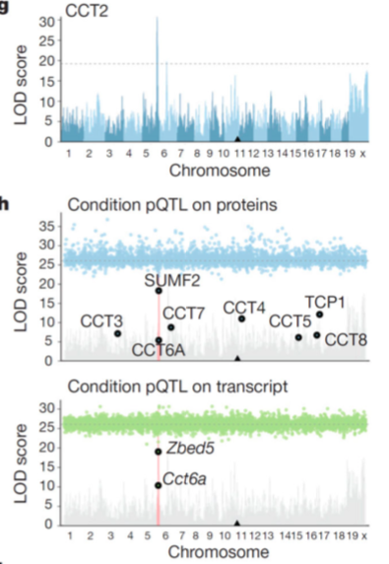
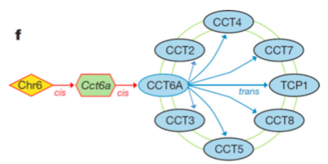
Mediation Analysis can Resolve Protein Networks
Distant pQTL on chr5 found to strongly alter CCT2 protein levels
CCT2 transcript located on chr10
CCT6a transcript mediated pQTL effect
Pathway of chaperonin proteins
Protein folding
Mediation Analysis
Notes:
CC T2 cr10

Slide 20
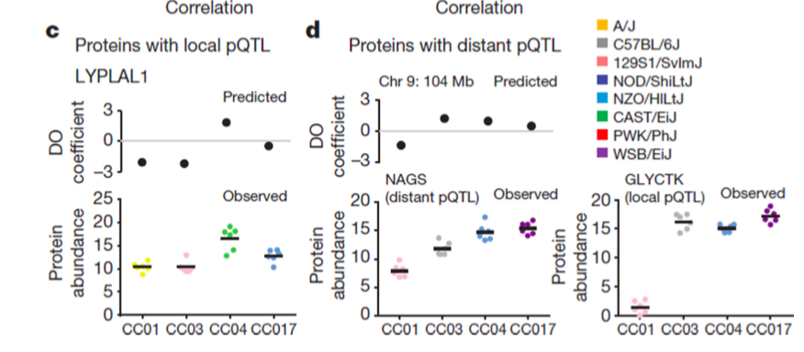
Genotype can Predict Protein Abundance
Can validate protein levels with CC carriers of genotype

Slide 21
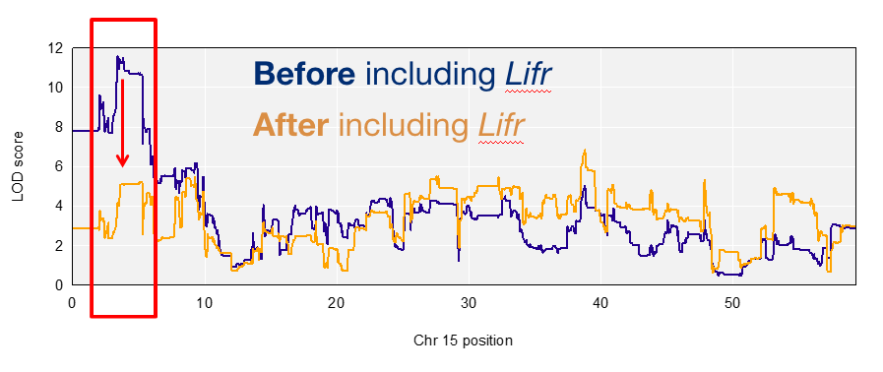
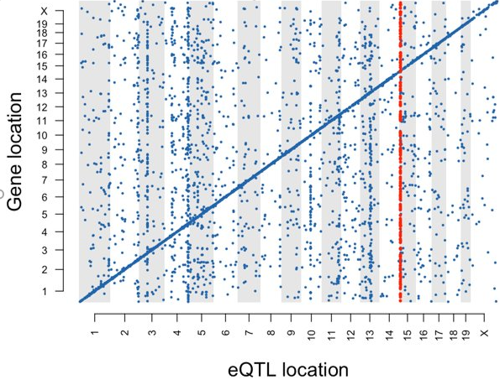
Other Applications: eQTLs in ESCs
Steve Munger’s Lab at Jax found eQTL for Lif receptor that alters many distant transcripts

Slide 22
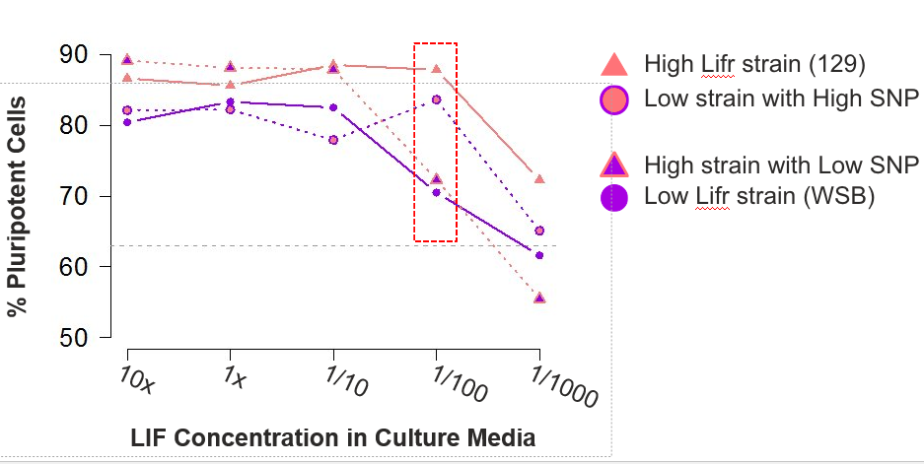
Validation by swapping genetic background

Slide 23
Current Work
Hunting down trans-bands in NPCs of the same lines
Cell fate QTLs using organoids (Lu)

Slide 24
